Slide 1
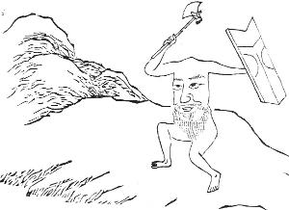
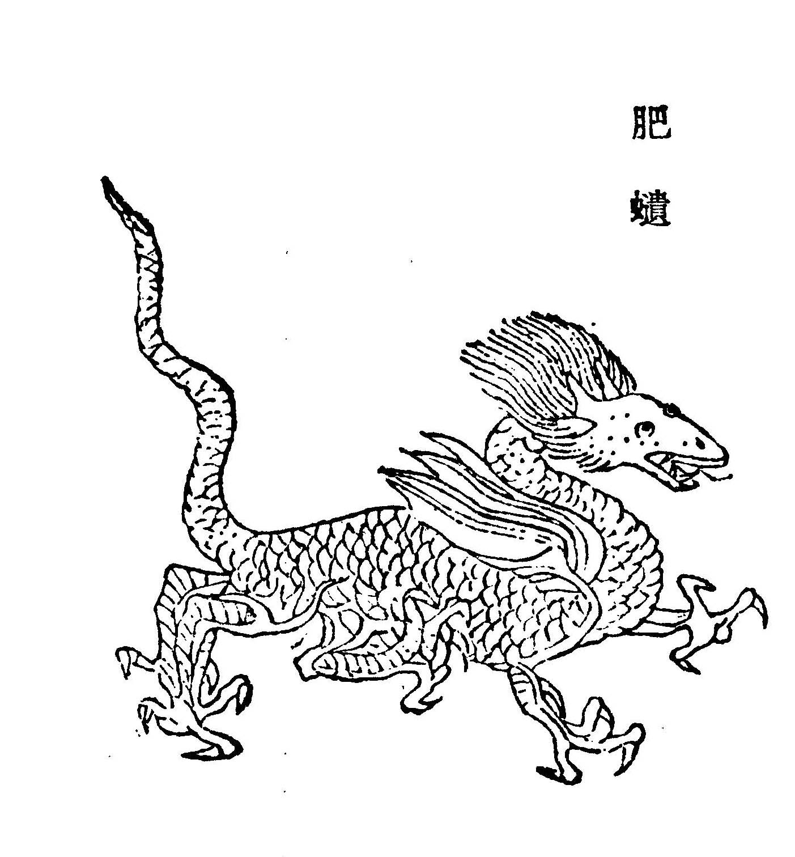
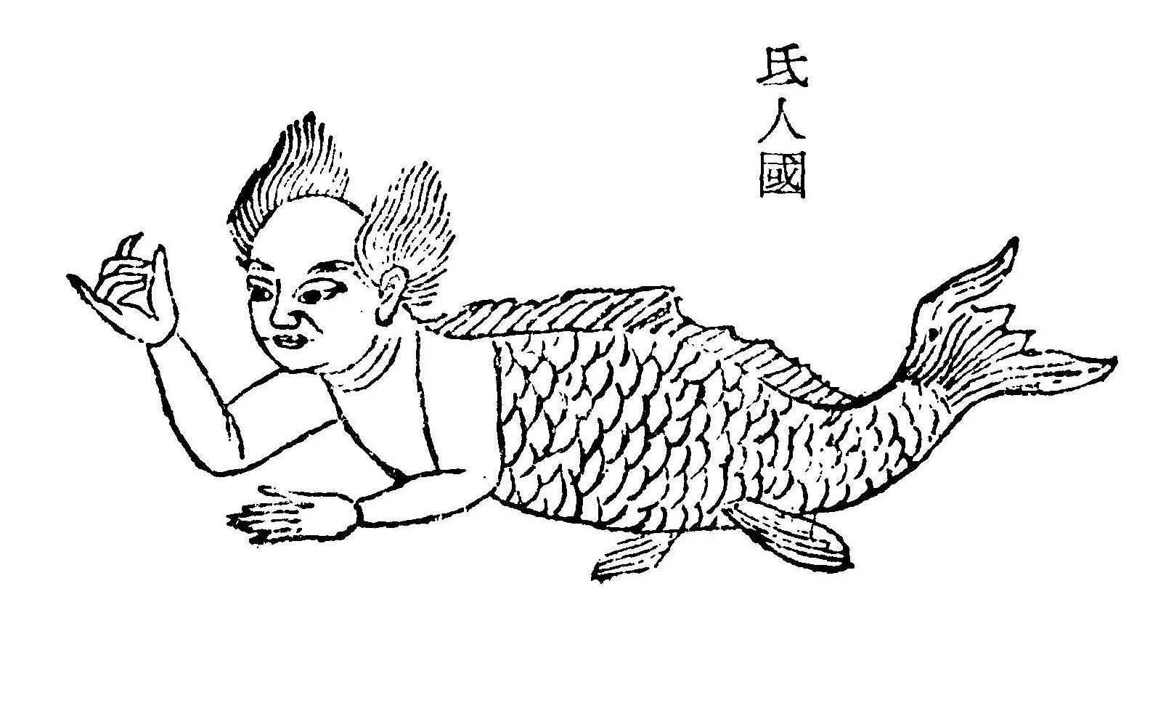
Analysis and Visualization of Narrative in Western vs Eastern Folktales Using Linked Data
Name : Qian Wang Supervisor: Ben Swift
Terhi Nurmikko-Fuller

Slide 2
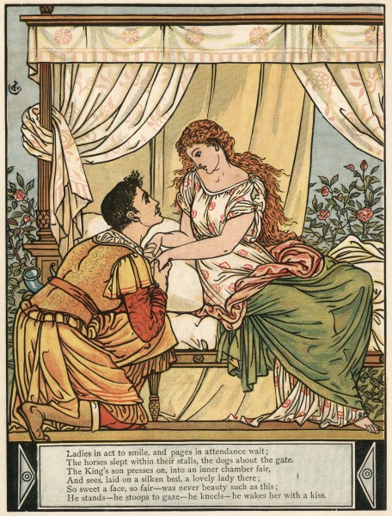
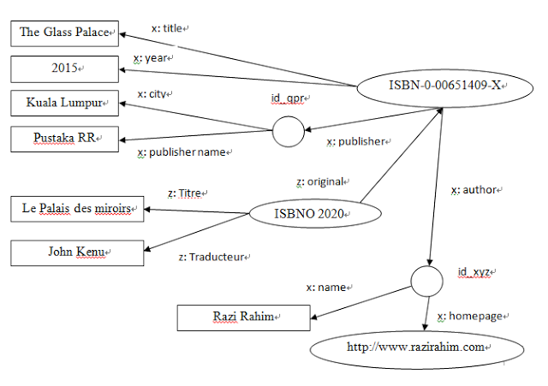

Slide 3
